Slide 1
ATM Machine Project

Slide 2
ATM Machine Account Create App
Module:
Login
SignUp
Transactions
Deposit
Withdraw
FastCash
Ministatement
Pin change

Slide 3
Functionality:
Procedure To Use App :
First,create the account in ATM Machine,
After login in the pages.
Deposite the Account and Add the Main Balance.
Withdraw the amount redisue the main Balance.
We Want any other option in go to the Transcation Page ,Which one option We want select the pin Change,BalanceEnquiry,
FastCash ,MiniStatement,Deposite,withdraw.

Slide 4
Summary
The topic of my project is the BankManagement System which contains ATM Machine account creation. It is a tool forcreate the account creation,deposit ,withdraw,Transcation,fastCash,Pin change and MiniStatement .
A List of the Login form in page Signin ,Signup and we have altreat create the account Card number and password Enter .
After Entering the Transcation Page deposite the account
Withdraw in the account and Fastcah withdraw option we want used.
After we have pin change the our Account new pin after going to login page Enter the Card number,password check the pin changes

Slide 5
Tools used:
Apache NetBeans
Core language
java
MySql yog

Slide 6
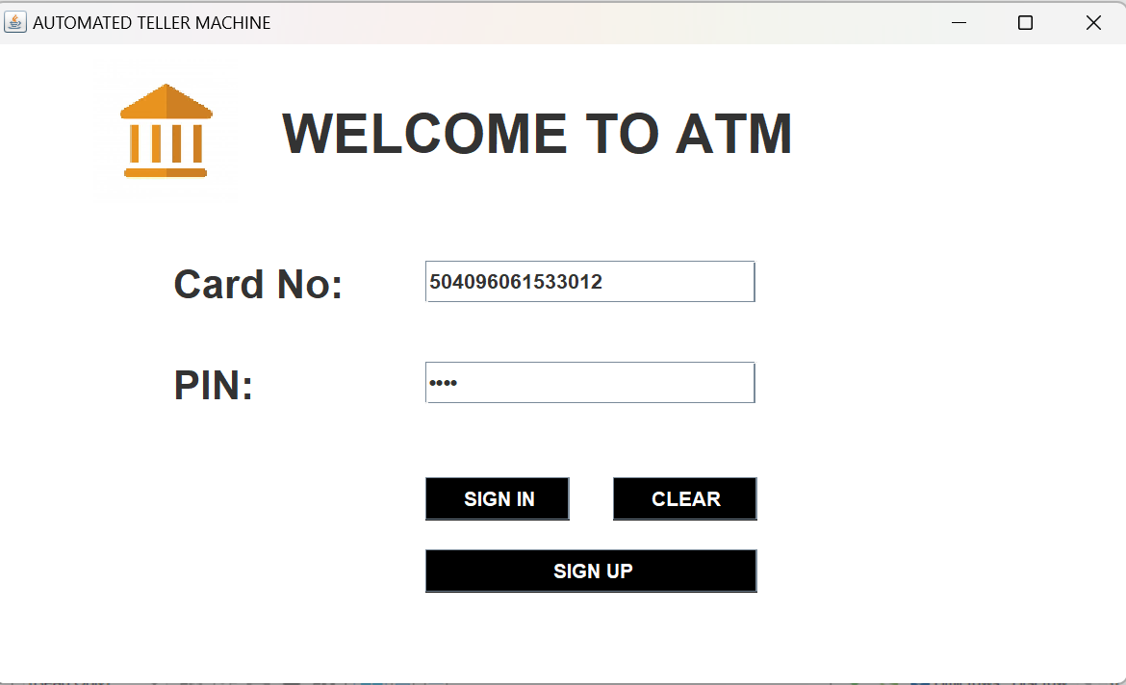
Front View Of Login App

Slide 7
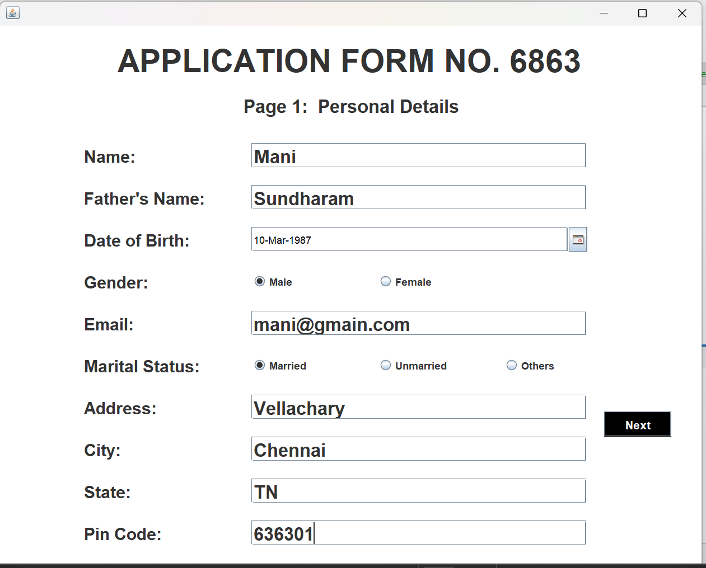
SignUp Enter the Customer Details:

Slide 8
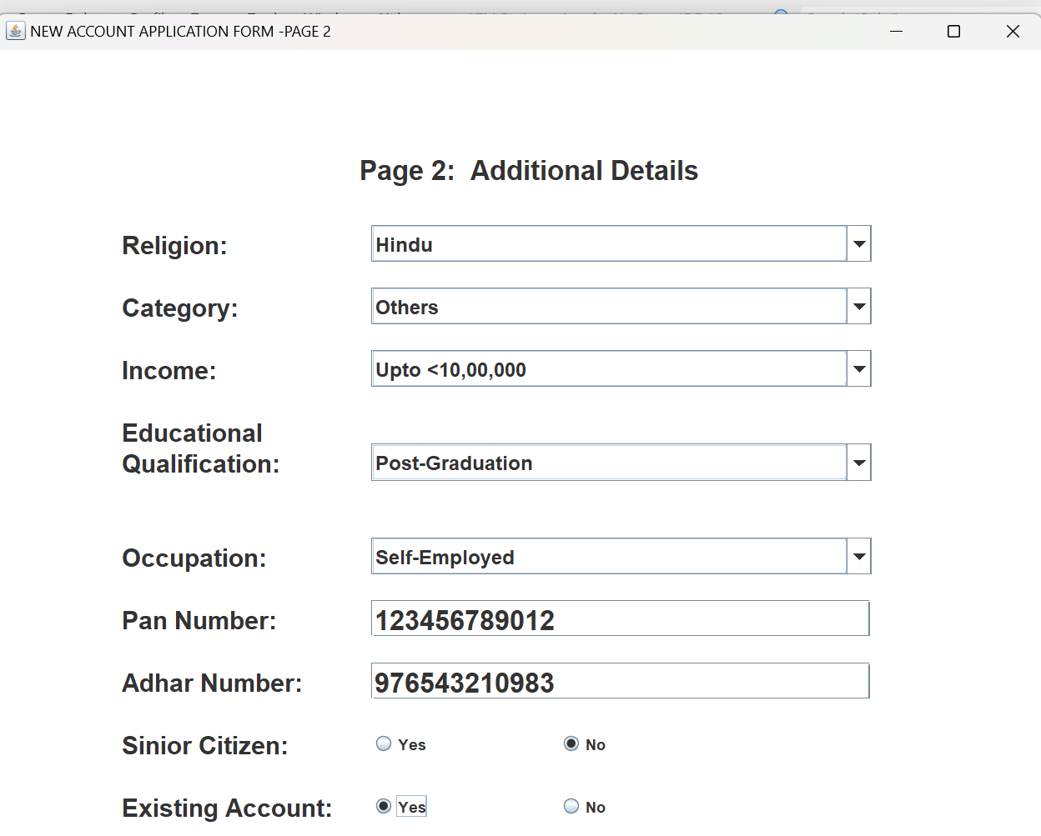
SignUpSecond Page

Slide 9
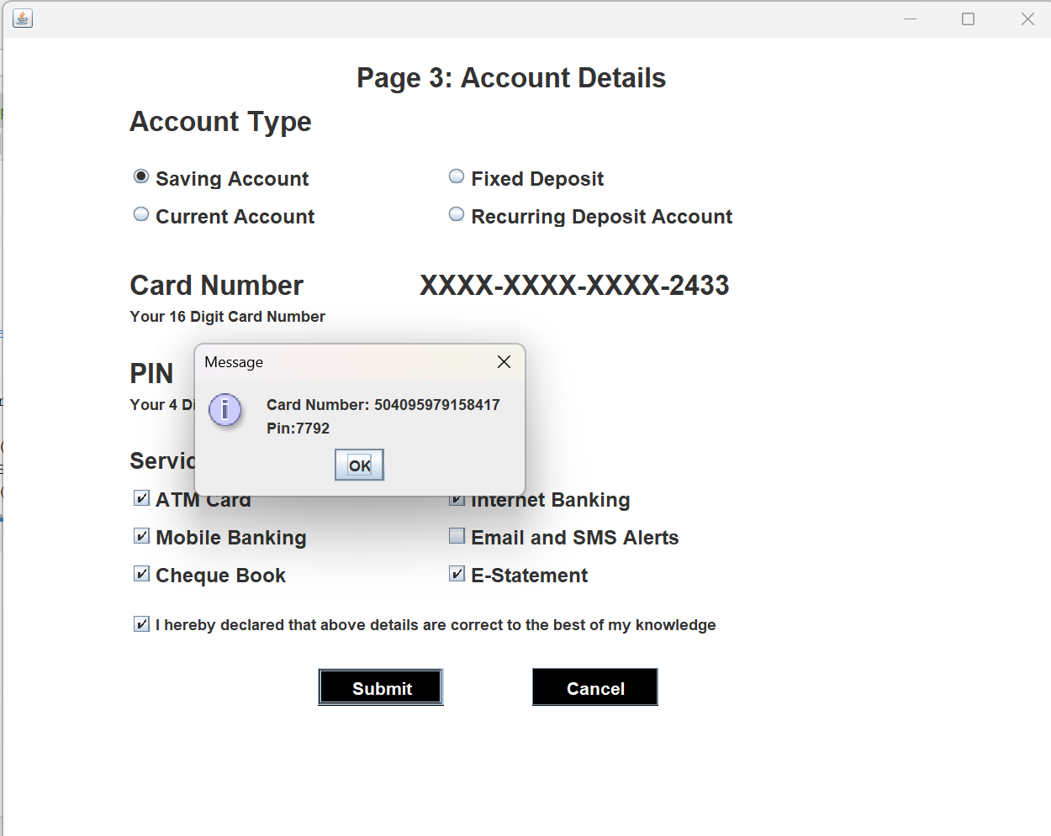
SignUpthree Page:

Slide 10
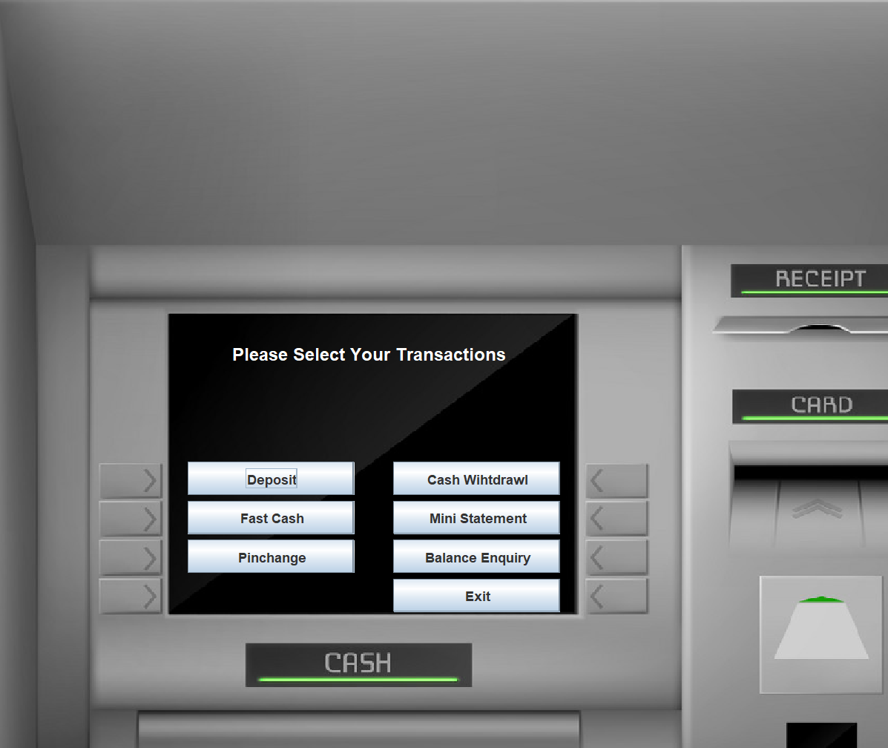
Transcatio page:

Slide 11
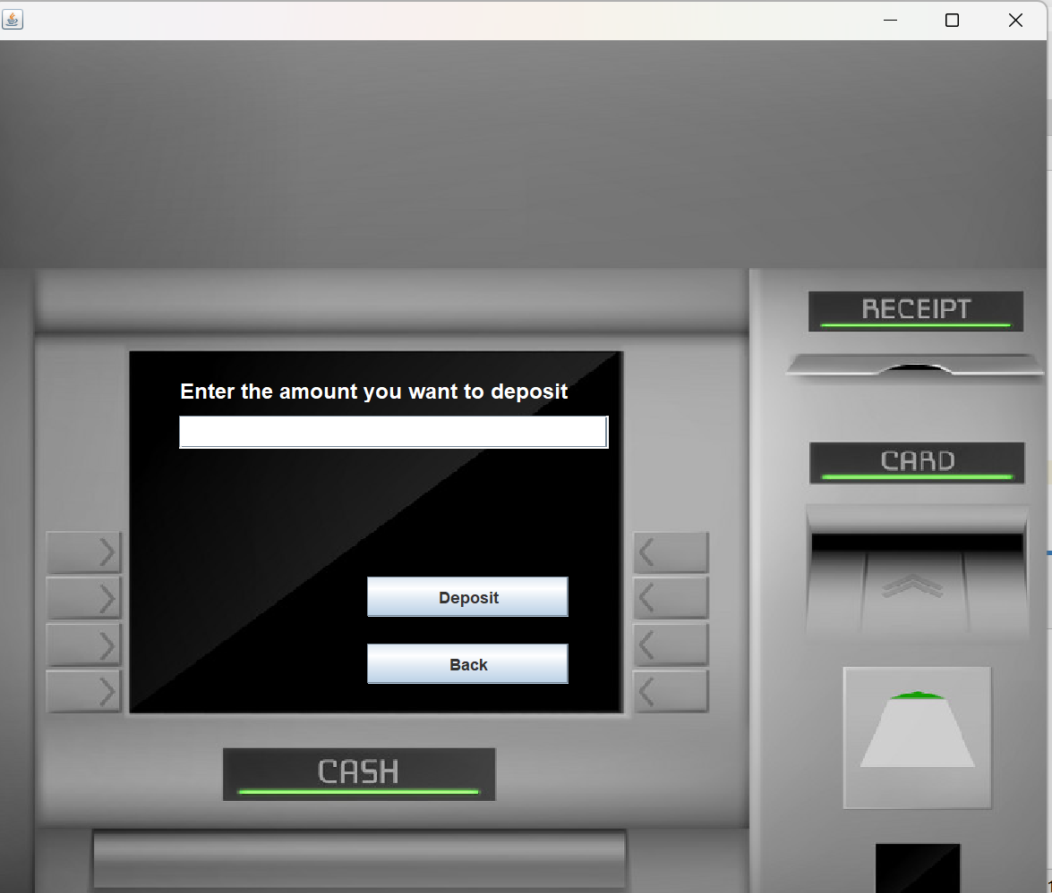
Deposite amount:

Slide 12
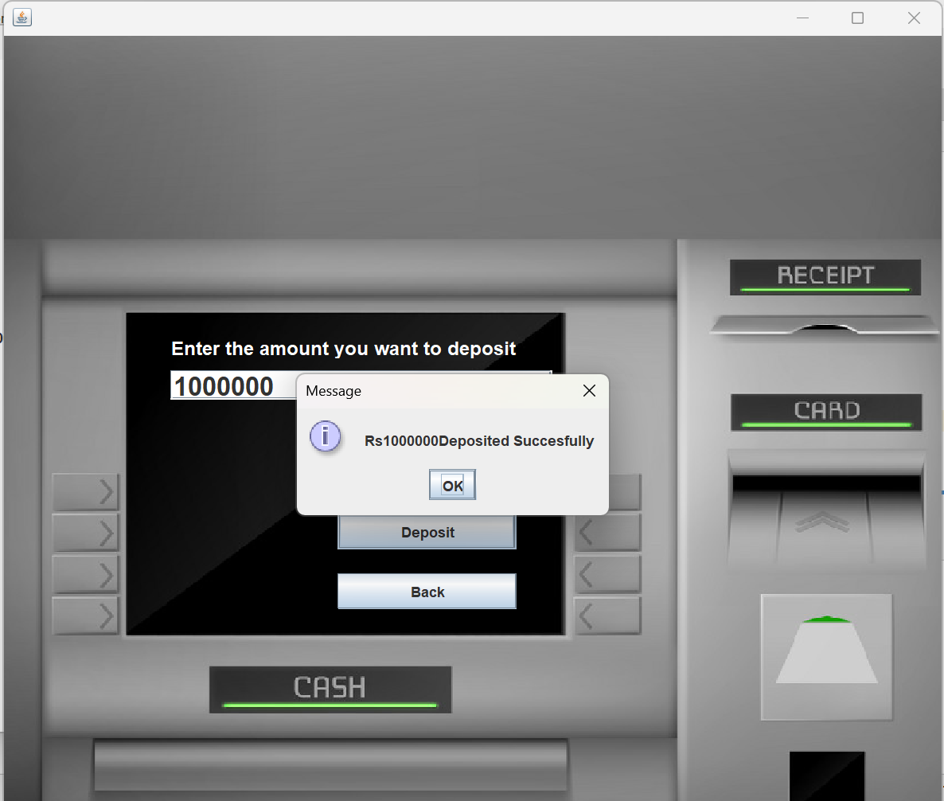
Deposite amount:

Slide 13
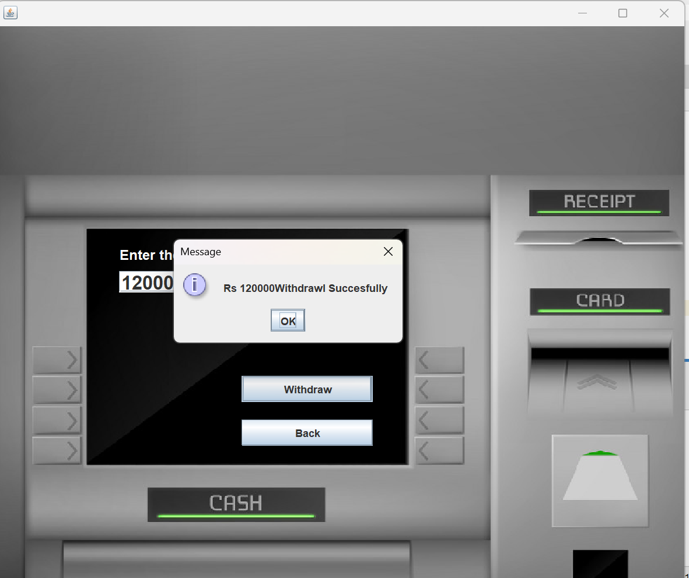
withdraw amount:

Slide 14
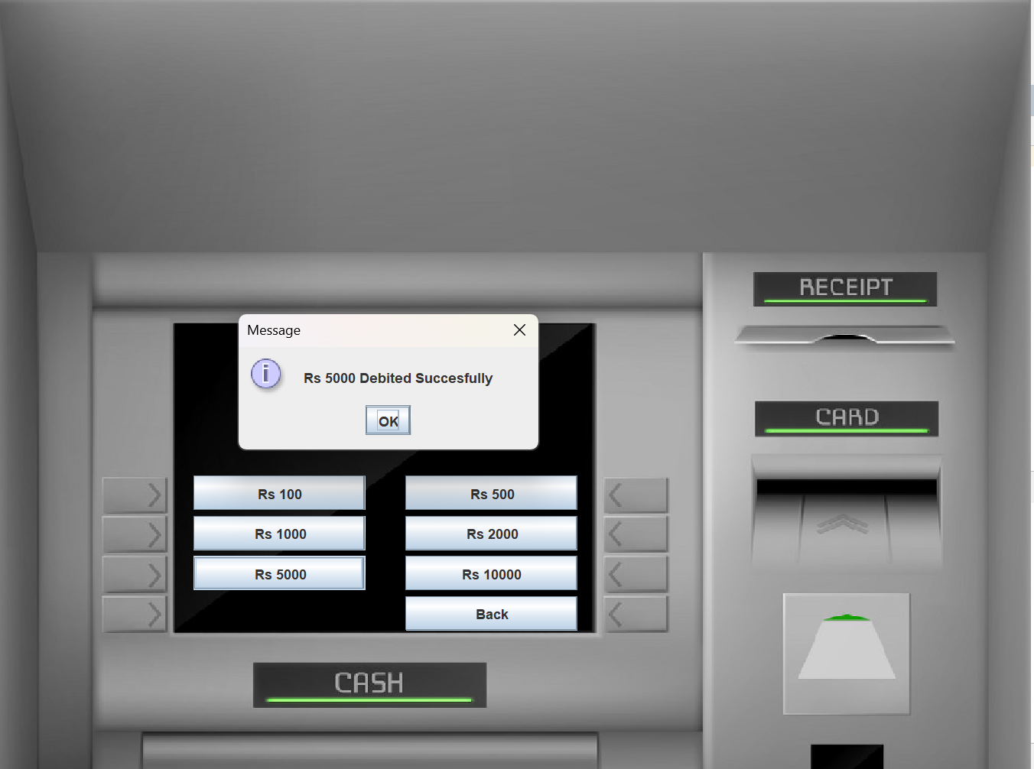
FastCash Amount

Slide 15
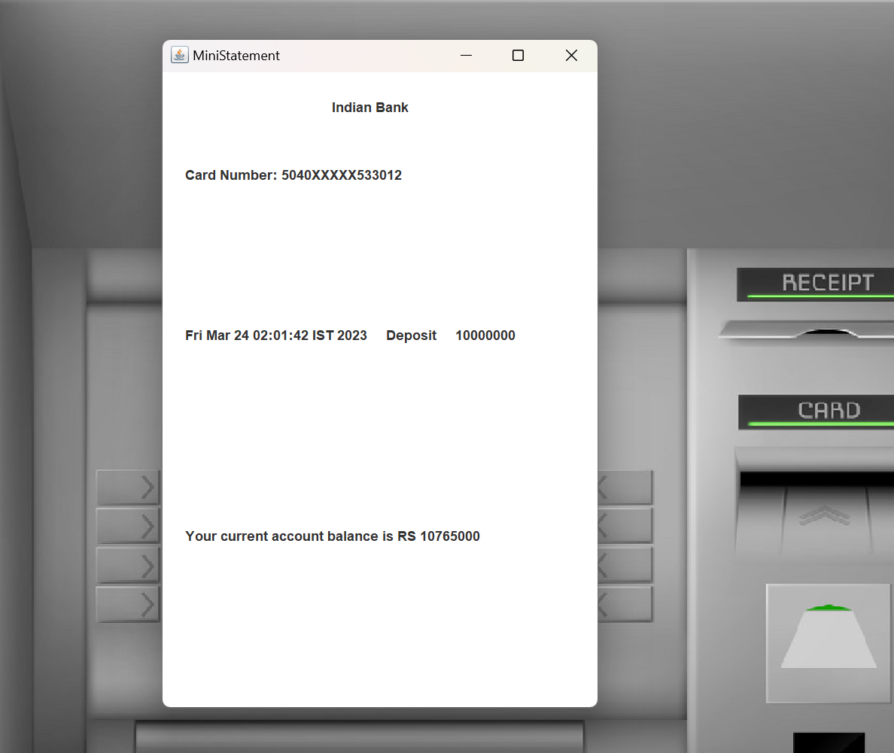
Ministatement:

Slide 16
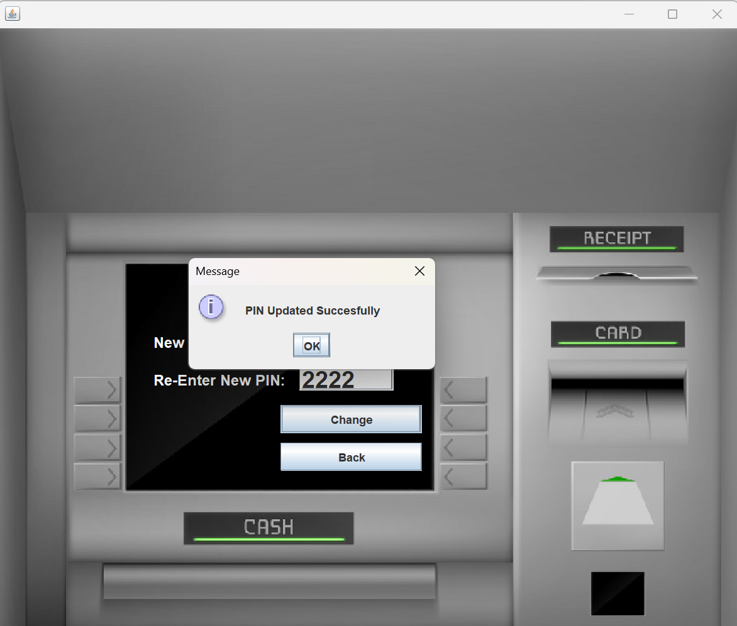
Pin Change:

Slide 17
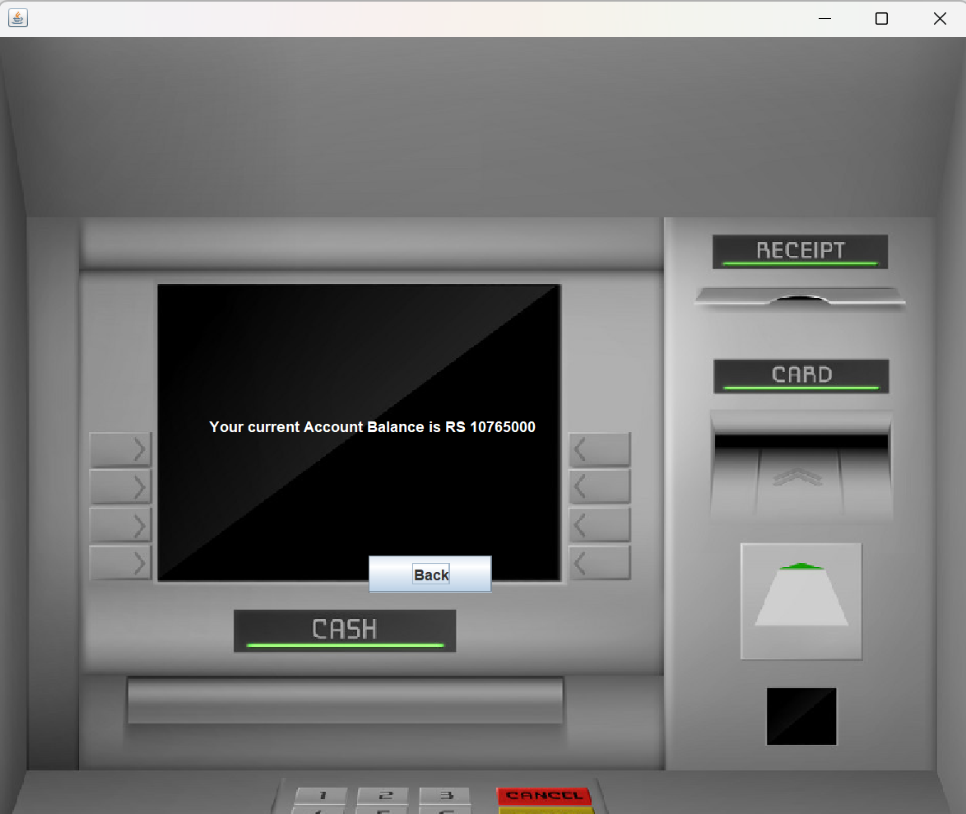
BalanceEnquiry:

Slide 18
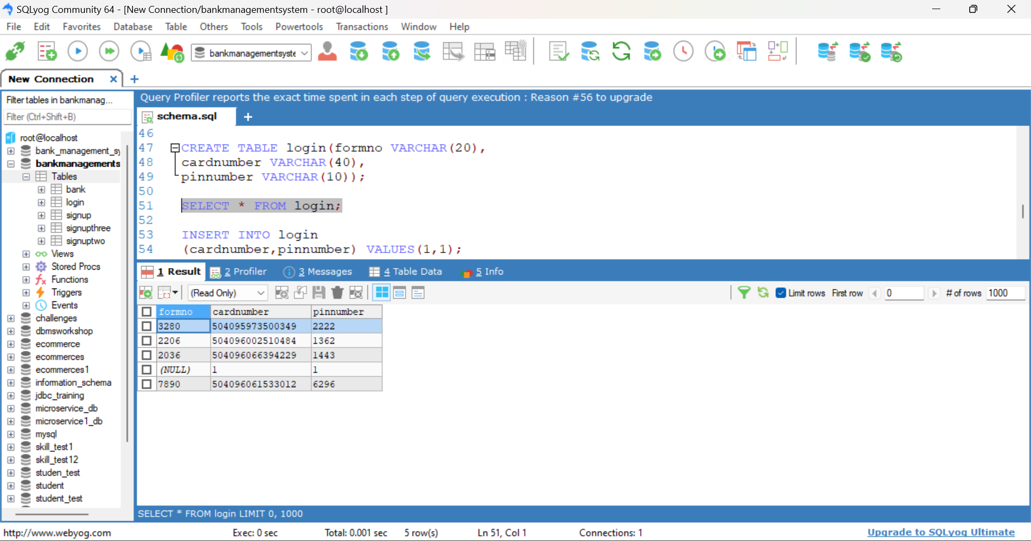
Created Login Data:

Slide 19
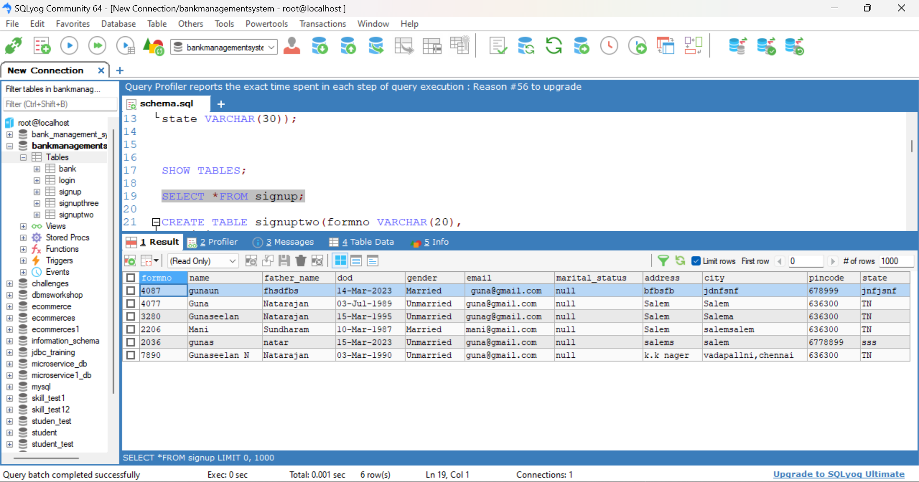
SigunUp Data:

Slide 20
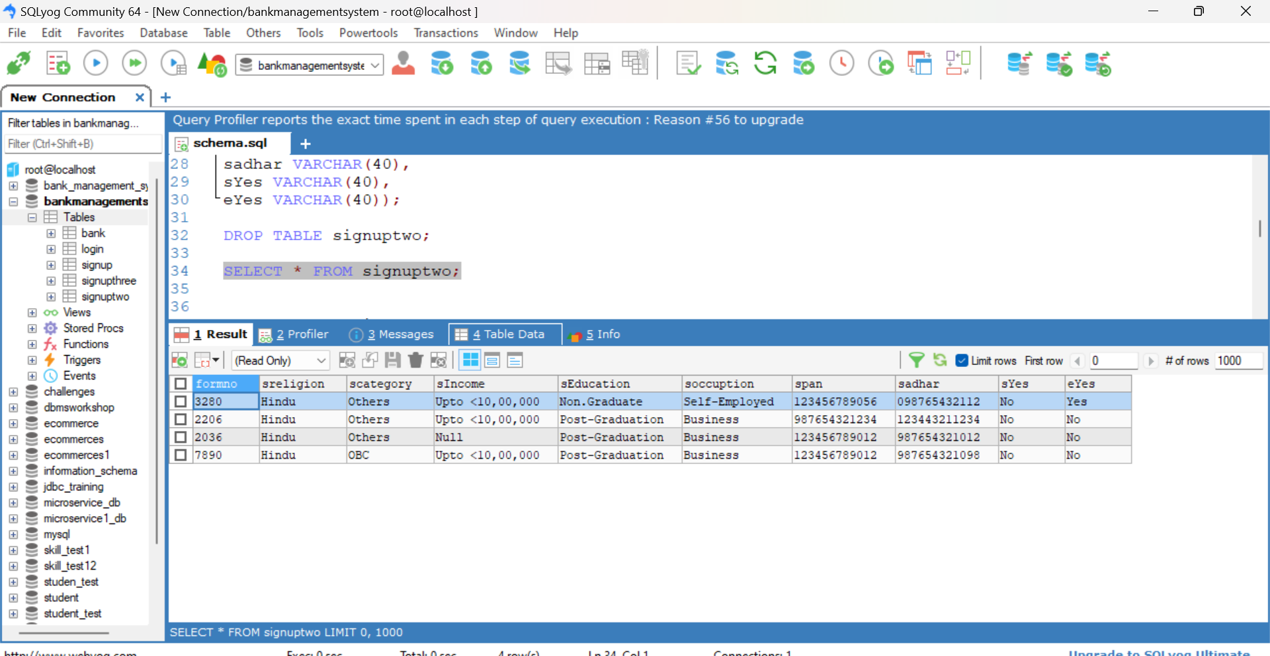
SignUpData:

Slide 21
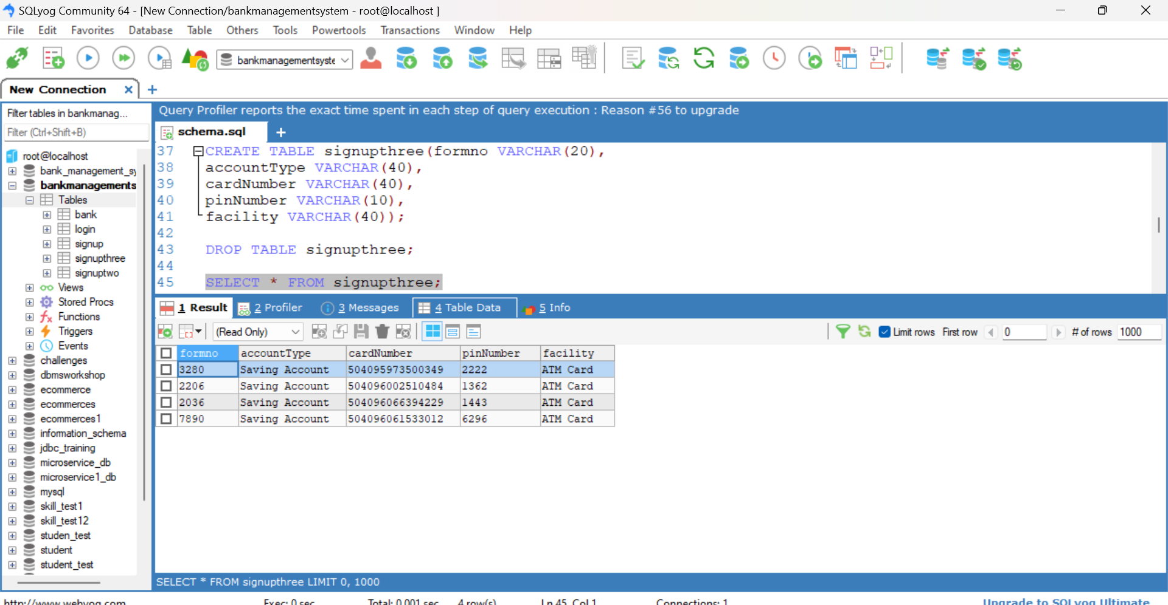
SignUp page is Create the Card number and Pin Number:

Slide 22
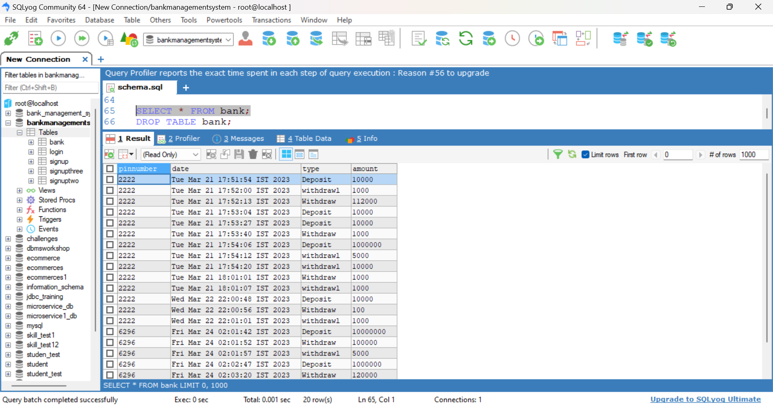
Bank Account Details:

Slide 23
Thank you

